Slide 1

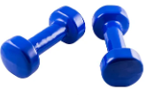
Westside High School
Oct 10-14 Week At a Glance
(WAG)

Slide 2
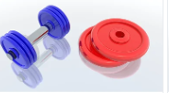
Coach Thomas
Weight Training: Oct 10-14

Slide 3

Monday - Agenda
Oct 10
Standard:
PEWT.4 The physically educated student exhibits responsible personal and social behavior
that respects self and others in physical activity settings.
a. Displays the ability to follow rules, procedures, and routines appropriate in the weight
training setting.
b. Exhibits the ability to demonstrate safe and responsible behavior.
c. Identifies the difference between encouraging and discouraging progression while
training.
d. Demonstrates the ability to apply the rules and etiquette of various weight training
activities
Learning Target
Opening ( 10-15 mins)
Work-session ( 20 - 25 mins)
Criteria for Success
Closing ( 05 – 10 mins)

Slide 4
Tuesday - Agenda
Learning Target
Oct 11 Standard:
PEWT.4 The physically educated student exhibits responsible personal and social behavior
that respects self and others in physical activity settings.
a. Displays the ability to follow rules, procedures, and routines appropriate in the weight
training setting.
b. Exhibits the ability to demonstrate safe and responsible behavior.
c. Identifies the difference between encouraging and discouraging progression while
training.
d. Demonstrates the ability to apply the rules and etiquette of various weight training
activities
Opening ( 10-15 mins)
Work-session ( 20 - 25 mins)
Criteria for Success
Same as previous day for lower body
Closing ( 05 – 10 mins)

Slide 5
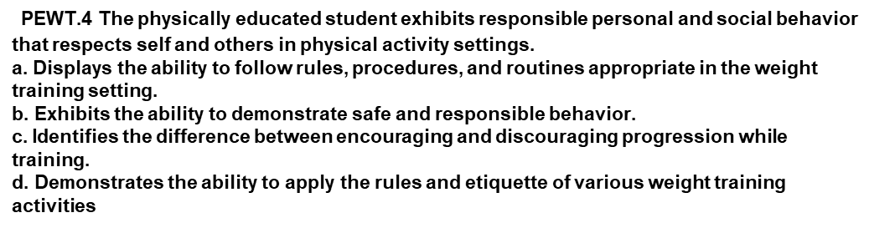
Wednesday - Agenda
Learning Target
Oct 12 Standard:
Same as Monday
Opening ( 10-15 mins)
5 minute Walk & Attendance
Work-session ( 20 - 25 mins)
Students will go through a circuit of upper & lower body strength exercises
Each students will get a free weight or kettle bell between 10-35lbs based on fitness level and utilize their weight during each exercise based on modeling done by coach
Circuit Exercises 1 minute each x 2
  Squat pulses with frontal lifts
  Double Lunges with oblique twist
  Side steps with chest press
  Calf raises with shoulder press
  Quick feet chin raises
Criteria for Success
Students can use the appropriate technique and skills while doing training exercises
Closing ( 05 – 10 mins)
-locker room unlocked for 5 minutes
-students use remaining time to cool down & rehydrate if necessary

Slide 6
Thursday - Agenda
Oct 13 Standard:
PEWT.4 The physically educated student exhibits responsible personal and social behavior
that respects self and others in physical activity settings.
a. Displays the ability to follow rules, procedures, and routines appropriate in the weight
training setting.
b. Exhibits the ability to demonstrate safe and responsible behavior.
c. Identifies the difference between encouraging and discouraging progression while
training.
d. Demonstrates the ability to apply the rules and etiquette of various weight training
activities
Learning Target
Same as Wednesday
Opening ( 10-15 mins)
5 minute Walk & Attendance
Work-session ( 20 - 25 mins)
Same as Wednesday
Criteria for Success
Same as Wednesday
Closing ( 05 – 10 mins)
-locker room unlocked for 5 minutes
-students use remaining time to cool down & rehydrate if necessary

Slide 7
Friday - Agenda
Learning Target
Oct 14 Standard:
PEWT.4 The physically educated student exhibits responsible personal and social behavior
that respects self and others in physical activity settings.
a. Displays the ability to follow rules, procedures, and routines appropriate in the weight
training setting.
b. Exhibits the ability to demonstrate safe and responsible behavior.
c. Identifies the difference between encouraging and discouraging progression while
training.
d. Demonstrates the ability to apply the rules and etiquette of various weight training
activities
Freestyle Friday
Opening ( 10-15 mins)
Attendance
Work-session ( 20 - 25 mins)
Students are able to engage in various activities/sports typically those that they are most interested
Teacher will conference will students and possibly make parent phone calls/contact as needed
MaKEUP DAY IF NECCESSARY
Criteria for Success
n/a
Closing ( 05 – 10 mins)
N/A

Slide 8
Resources
https://www.nike.com/nrc-app
https://www.rcboe.org/westside

